Slide 1
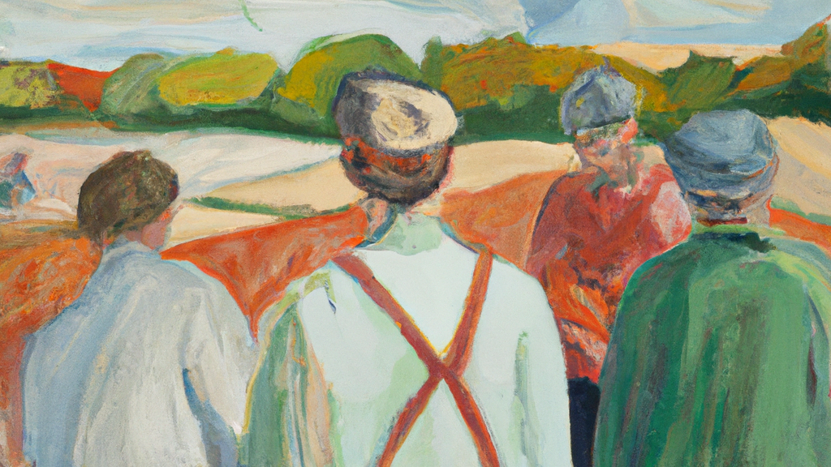
Who is Who?
Natural Language Processing applied to Swedish Historical Biographies

Slide 2
Outline
Purpose
Source
Steps
Examples
Descriptive statistics
Tips

Slide 3
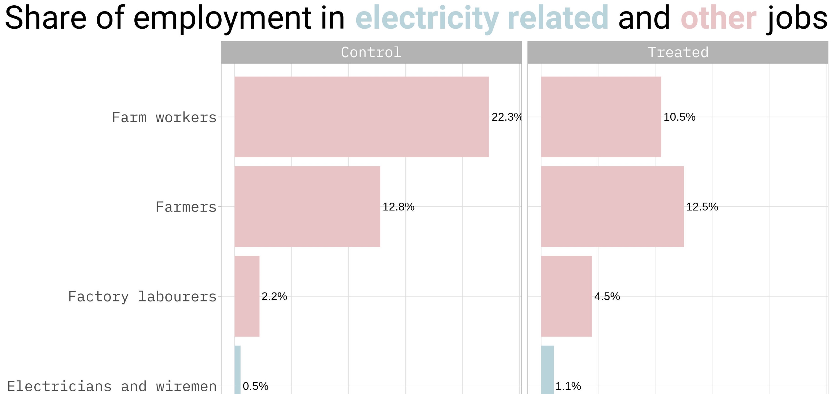
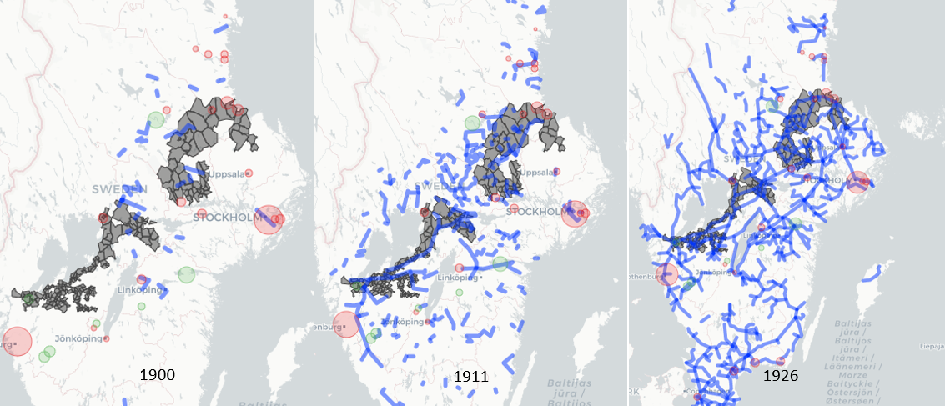
Why do we care about the 2nd Industrial Revolution?

Slide 4
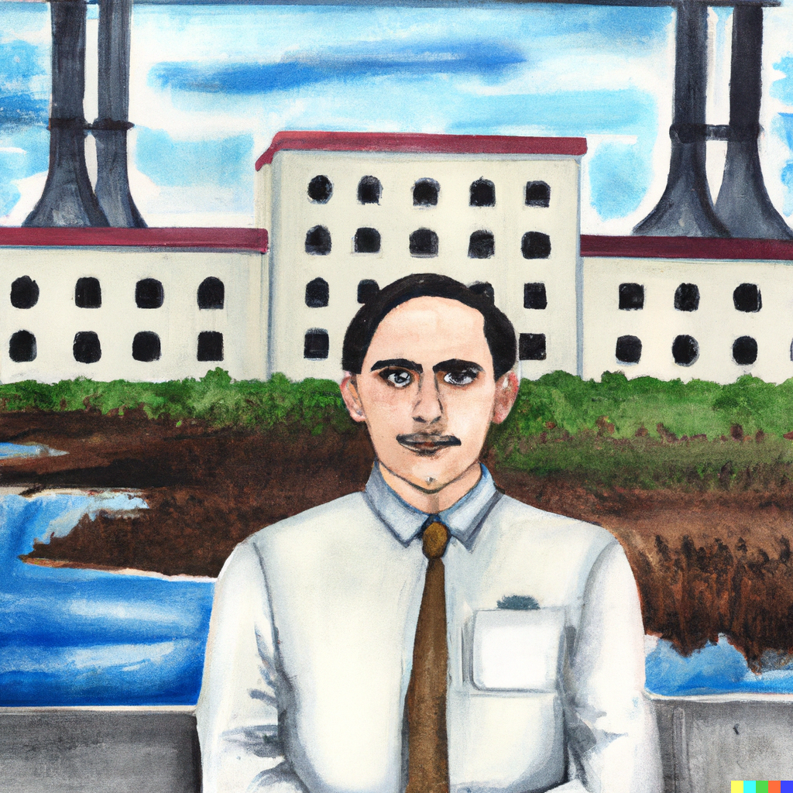
Purpose
RQ: How important is specific education or training in different sectors during the 2IR in Sweden?
Notes:
We know that to be a doctor and a dentist you need to have a university degree from a medical school.
We know that there are many surveyors and engineers produced.
But for electricity, how much on the job training can you get that can take the place of electricity?

Slide 5
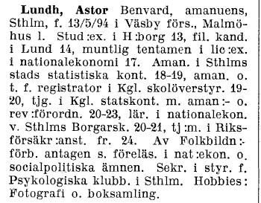
Source of historical biographies
Vem är Vem is a Swedish biographical encyclopedia that was published in two editions of five volumes each in 1945–1950 and 1962–1968 by Bokförlaget Vem är Vem.
The intention was, according to the publishers, to draw attention to people who were at the height of their activities, even if they were younger in influential or otherwise noted positions in different areas
We get career trajectories of 30,000 individuals!
Digitized by librarians in Uppsala – thank you <3

Slide 6
🧑
📝
🗑️
📚
🎓
💼
💻🧹
Notes:
We want to take unstructured biographical data, transform it with natural language processing, and get a neat structured set of data on individuals schooling, post-schooling education or training, and their occupations.

Slide 7
NLP Challenges
Many abbreviations
Similar structure for each entry but not exactly the same information in the same order
Notes:
What makes it difficult? We could do this by looking for specific words or names of educational institutions – however it’s really challenging with many idiosyncrasies.
Sometimes there is information about the persons parents and wife, other times this is missing.

Slide 8
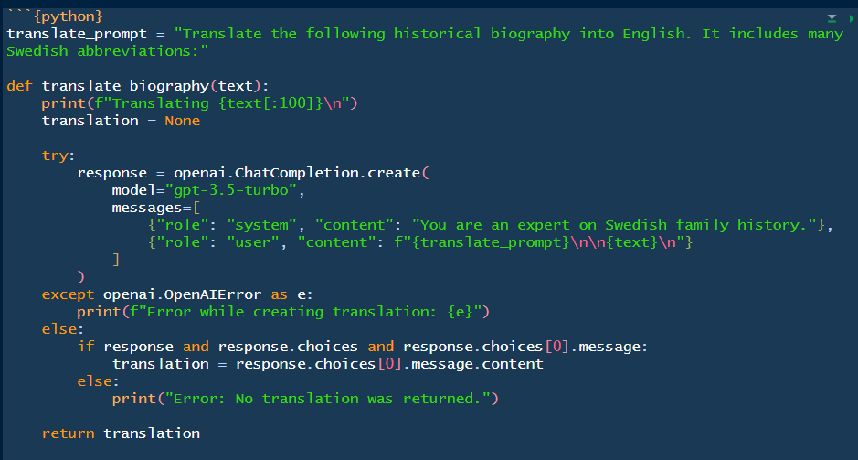
Steps
Translate
Structure
Augment
Notes:
Use the Send to OpanAI API

Slide 9
Translate: output
Lundh, Astor Benvard, clerk, Stockholm, born May 13, 1894 in Väsby parish, Malmöhus county. Passed the student exam in Helsingborg in 1913, earned a Bachelor of Arts in Lund in 1914, and passed the oral examination for a degree in economics in 1917. Was a clerk at the Stockholm City Statistical Office from 1918-1919, and a clerk and substitute registrar for the Royal School Board from 1919-1920. Served in the Royal Audit Office as a clerk and auditor from 1920-1923, and was a teacher of economics at Stockholm Private High School from 1920-1921. Also worked for the National Insurance Agency from 1924. Accepted as a lecturer on economics and social policy by the Popular Education Association. Secretary of the Board of the Psychological Club in Stockholm. Hobbies included photography and book collecting.

Slide 10
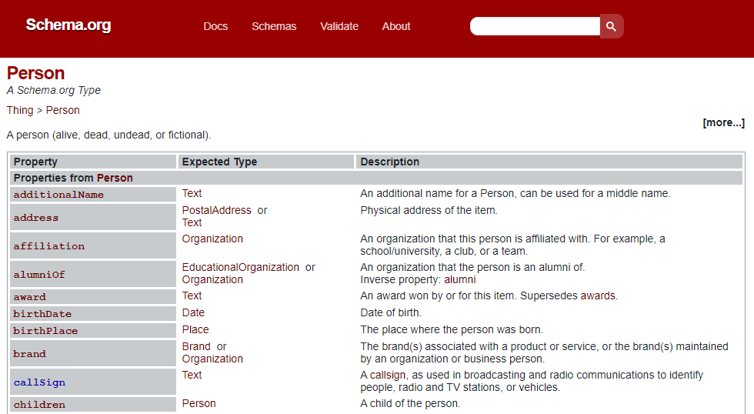
Structure

Slide 11

Schema prompt
Convert this biography into schema.org/Person format.
Include information on birthDate, birthPlace, education, occupation, family, parents where possible.
Return any other notable information in a field called 'description' where possible.
Include startDate and endDate wherever possible.
Only provide a RFC8259 compliant JSON response

Slide 12
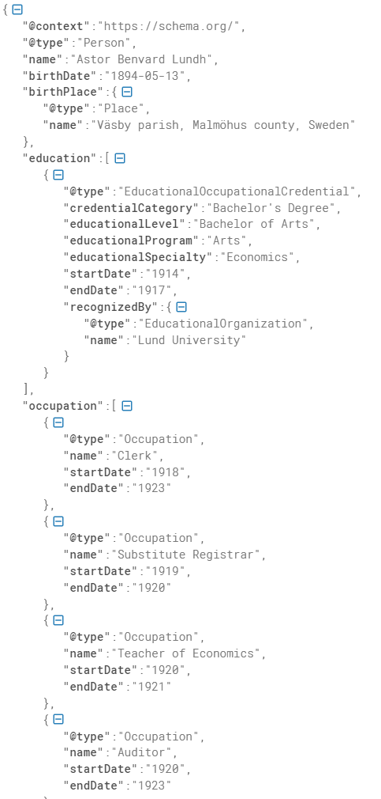
Structure: output

Slide 13
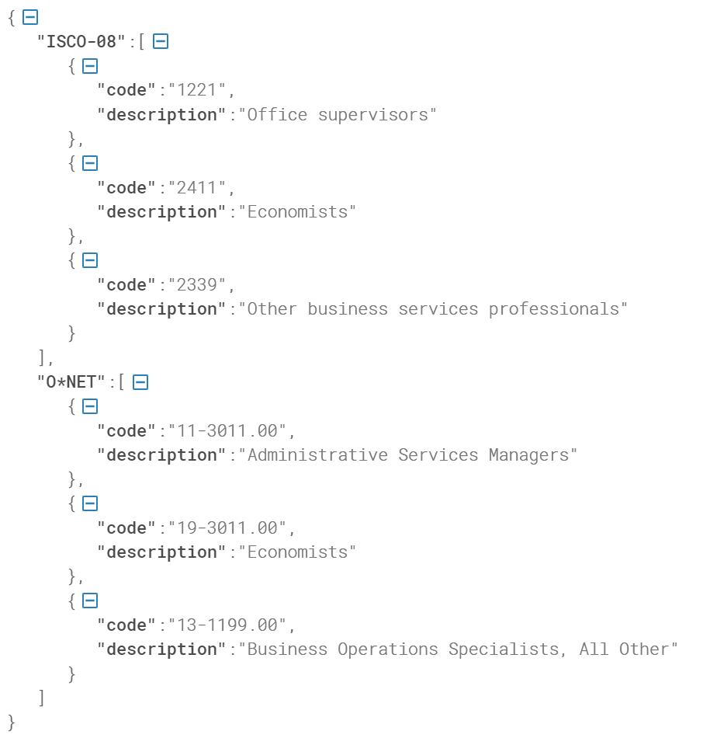
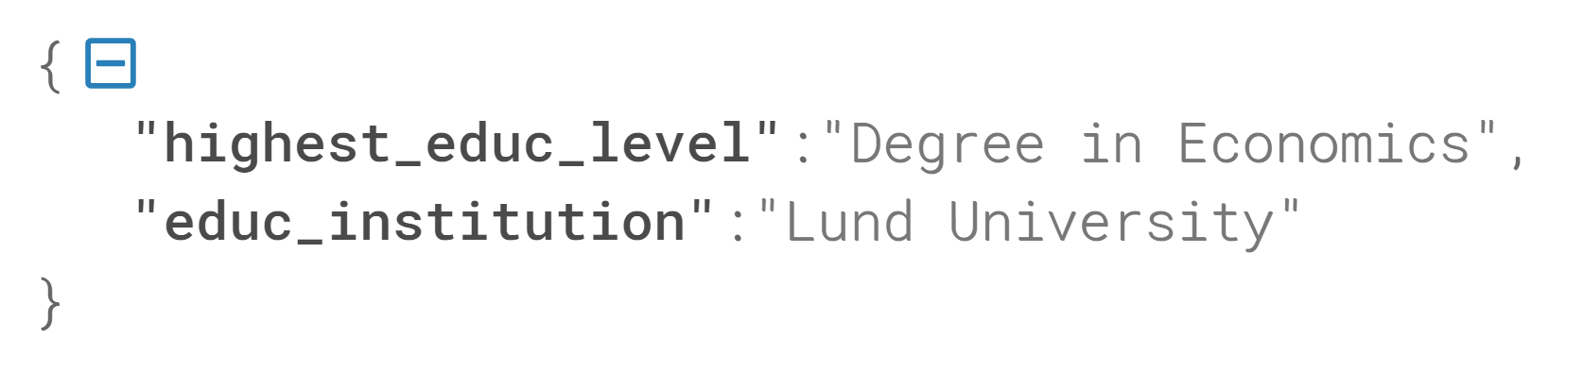
Augment: output education and occupations

Slide 14
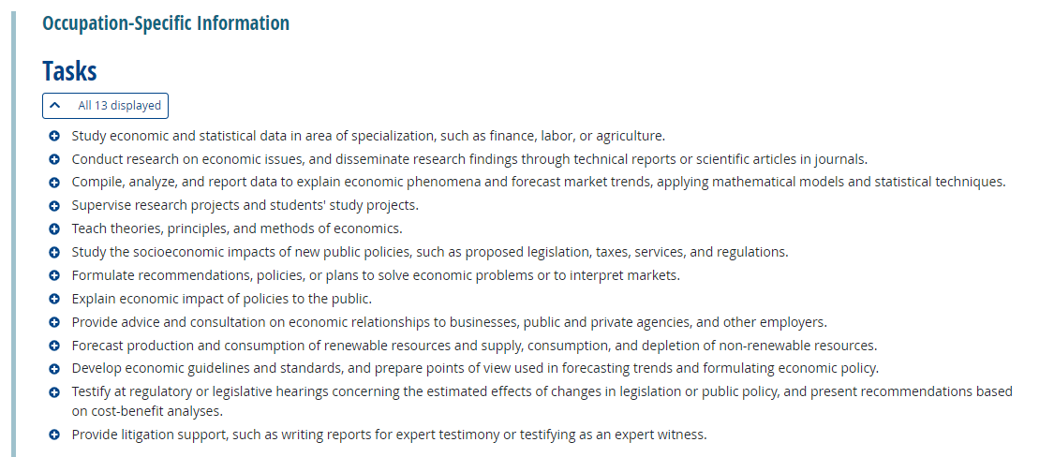
Augment: occupation with O*Net tasks

Slide 15
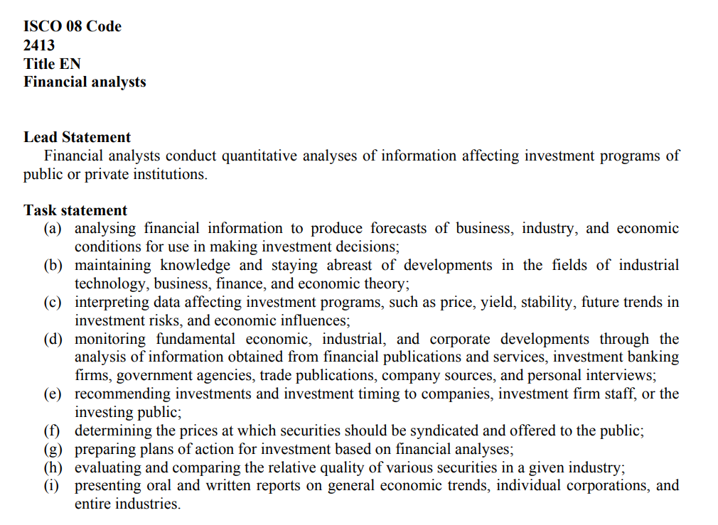
What went wrong?
Some of the occupational codes are wrong:
“Employed at the ship brokerage firm Nordström & Thulin in Stockholm since 1898, became a certified broker in 1933”
Given code: {'code': '1212', 'description': 'Ship and aircraft controllers'}, {'code': '2413', 'description': 'Enterprise and operational risk analysts'}

Slide 16
Tips for getting the GPT to work well
Give context
“You are an expert in Swedish family history”
Improved the translation of contractions and abbreviations
Provide structure
Be specific in the content that you want to get back
“* Include startDate and endDate wherever possible.”
“* Only provide a RFC8259 compliant JSON response”

Slide 17
Context: current world to history
We’re interested in the 2nd industrial revolution
The people on the ground implementing these technologies – explain why we care about them.
Technical high schools?
Cluster of people trained around ASEA – electrical firm. 1892 – skill specific to the firm. Did they come from the mining industry?
Look at electricity related jobs.
Can we link to patent holders
Recruitment

Slide 18
Example of Job Ads from JobTech
What do the job ads contain?

Slide 19
Example of Job Ads from JobTech
What do the job ads contain?

Slide 20
How do we answer the question
What skills and combinations of skills would we need to get someone from different levels
Unemployed to employed in a basic job (bottom quintile of employment)
Basic job to more advanced job (up a quintile)
The literature is about education – here we can measure the skills
How are the skills combined?

